Slide 1
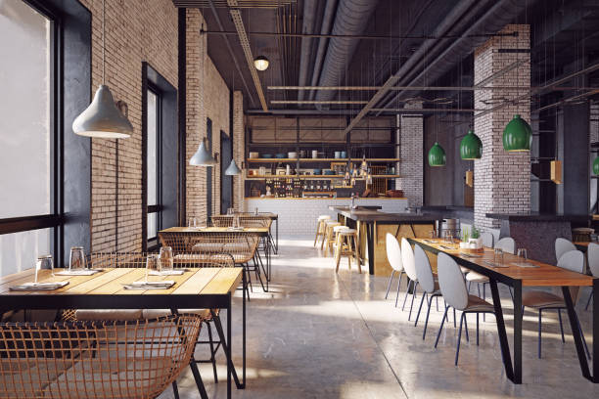

Slide 2
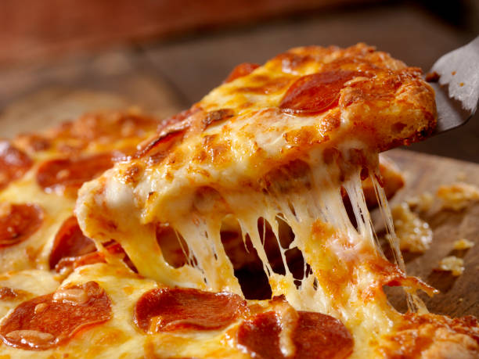
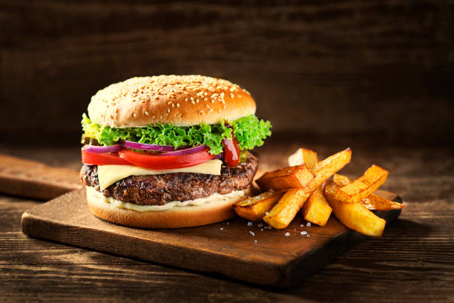
INTRODUCTION
There is various factor which helps to run restaurant with profitability, smoothly and in perfect way. But among them restaurant menu is most important thing. Because in restaurant, profit can be generated by selling foods and it is very important to manage the restaurant menu system.
The main aim to design this project is to make systematic order system, manage the flow of increasing customer in peak time and facilitate customer with user friendly system where customer can order anything they want in any quantity and get instant bill.

Slide 3
PROBLEM STATEMENT
The traditional method to accept the restaurant order is to provide menu first and then customer will give their order and human resource is required to collect order and to serve the order. This process will take lots of time to place and get the order. And there are high chances of human errors in ordering and billing, to overcome this problem and to run restaurant smoothly this system was developed.

Slide 4
OBJECTIVE
To develop a system for better user experience with interactivity.
To tailor the smooth operation with less delay and reduction in operational confusion.
To integrate proper methods and methodologies which are used for designing and developing the system in systematic approach.
To integrate technology and automation in food service industry for efficiency.

Slide 5
FEATURE
Multiple orders can be received and processed simultaneously.
Digital Menu can be easily updated and configured as per the requirement.
Quick billing and item ordering.
Detail description of the dish including price list serving size etc.

Slide 6
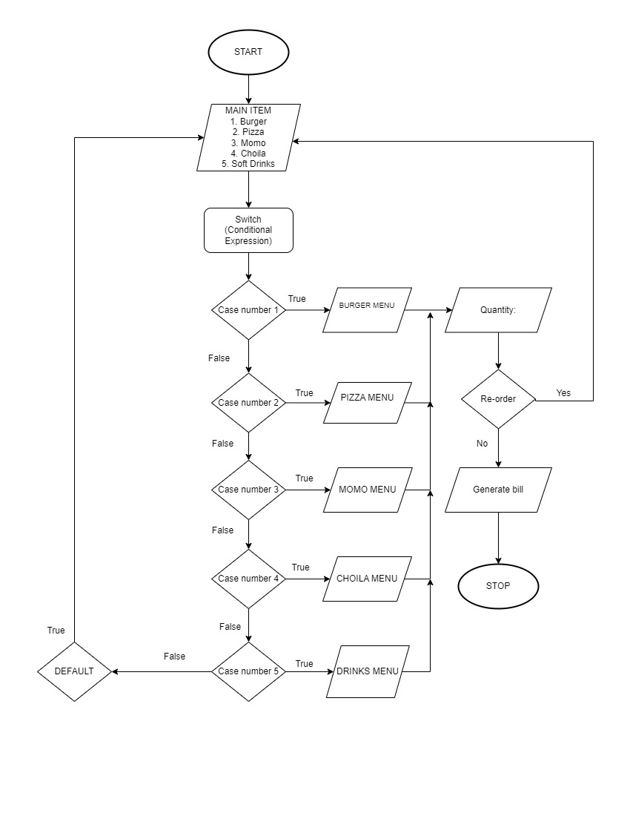
FLOWCHART

Slide 7
ALGORITHM
Step 1: Start
Step 2: Main item 1. Burger 2. Pizza 3. Momo 4. Choila 5. Soft Drinks.
Step 3: Enter choice.
Step 4: case 1 goes to Burger Menu with ordering quantity facility.
Step 5: Click re-order for the food that goes to main item menu otherwise generate bill.
Step 6: case 2 goes to pizza menu with ordering quantity facility.
Step 7: repeat step 5.
Step 8: case 3 goes to Momo menu with ordering quantity facility.
Step 9: repeat step 5 process.
Step 10: case 4 goes to choila menu with ordering quantity facility.
Step 11: repeat step 5 process.
Step 12: case 5 goes to soft drinks menu with ordering quantity facility.
Step 13: Default goes to the main menu.
Step 14: stop

Slide 8
EXCEPTED OUTPUT

Slide 9
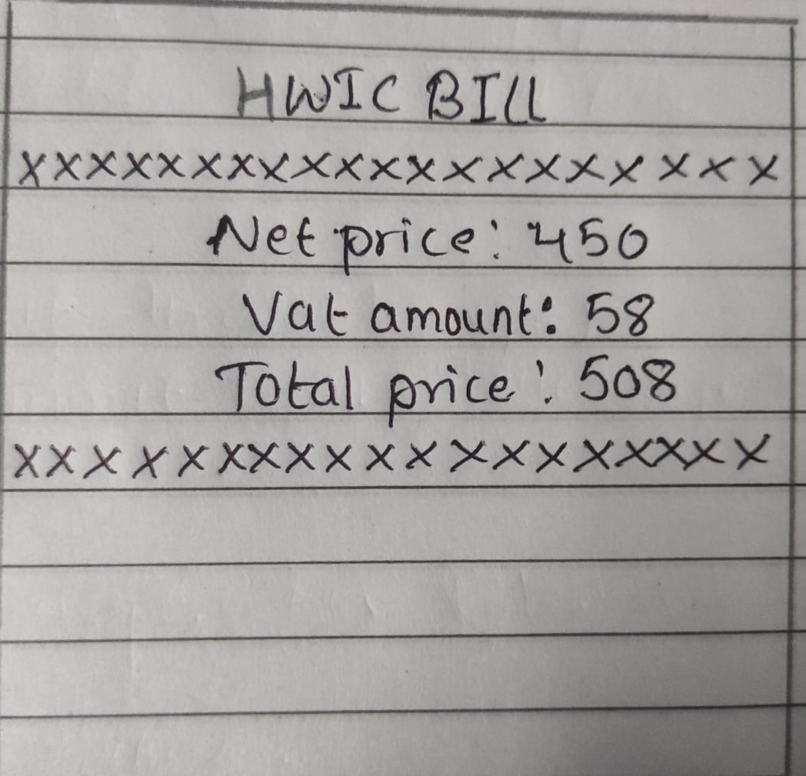

Slide 10
BIBLIOGRAPHY
Torres, Arnelyn. (2016). Electronic Menu and Ordering Application System: A Strategic Tool for Customer Satisfaction and Profit Enhancement. International Journal of u- and e- Service, Science and Technology. 9. 401-410. 10.14257/ijunesst.2016.9.4.39.

Slide 11
Gantt chart

Slide 12
THANK YOU !

